Slide 1
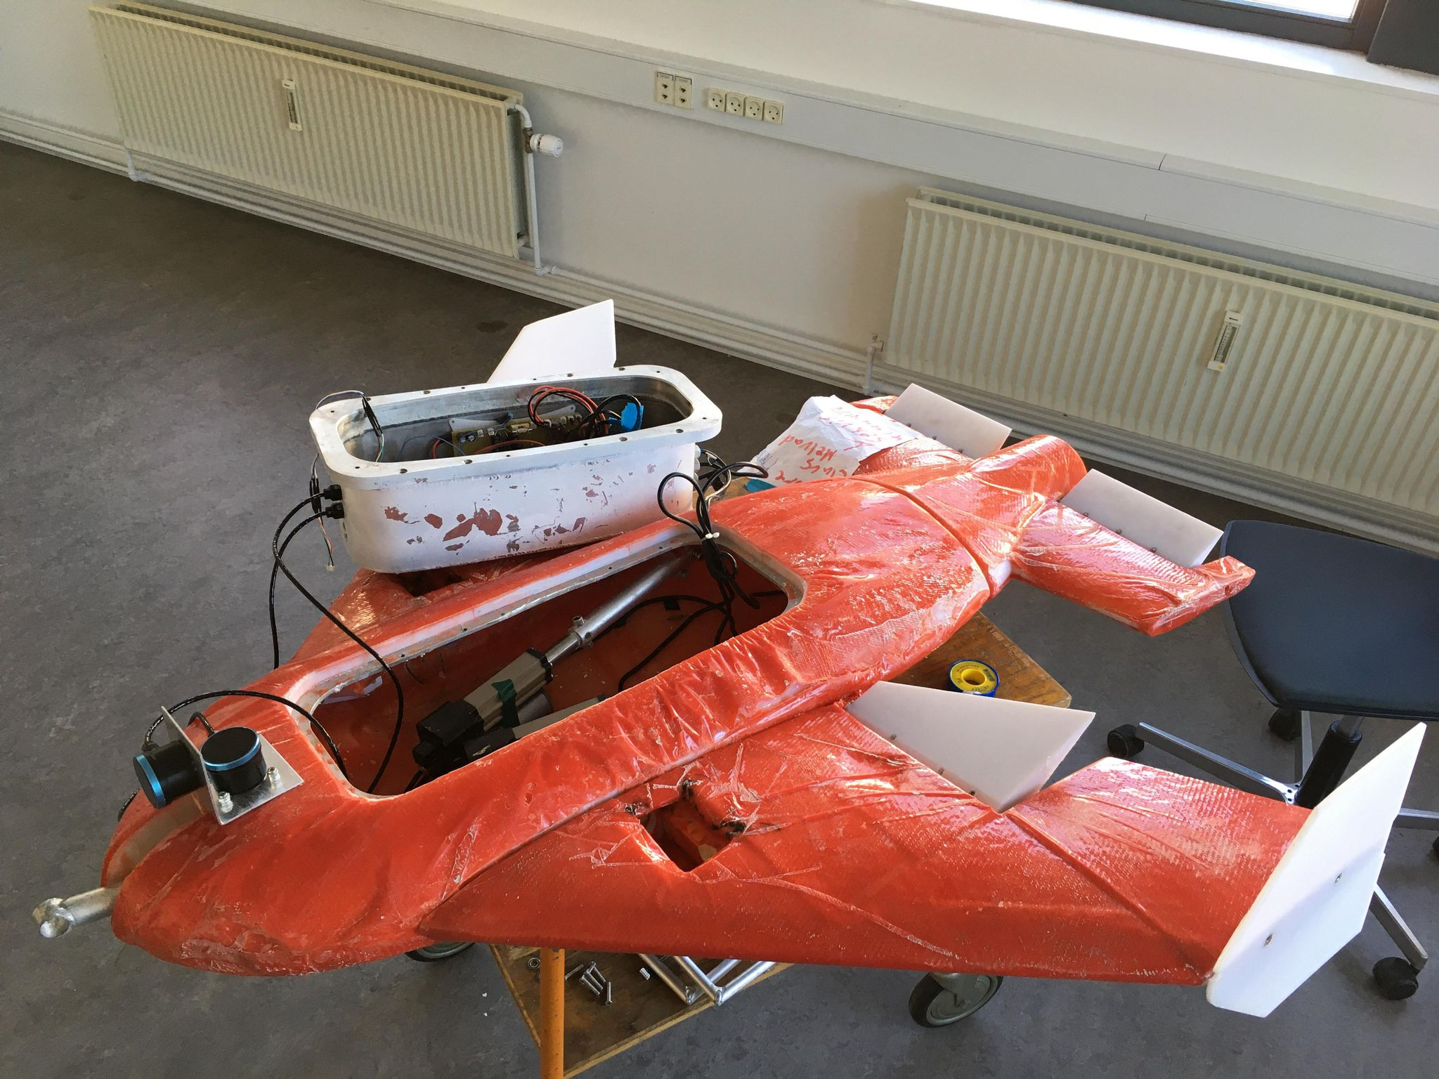
SeaVis drone Control system

Slide 2
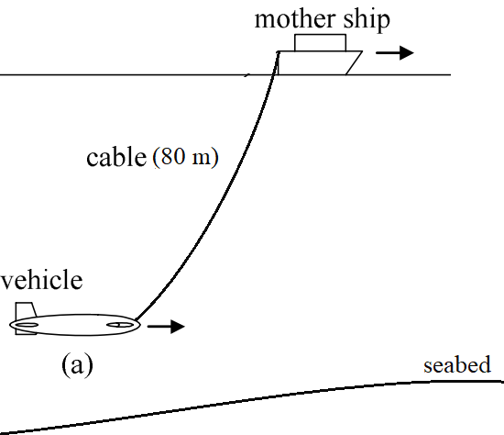
Overall objective
Develop control system in order to maintain a specific height above the seabed while keeping zero pitch and roll

Slide 3
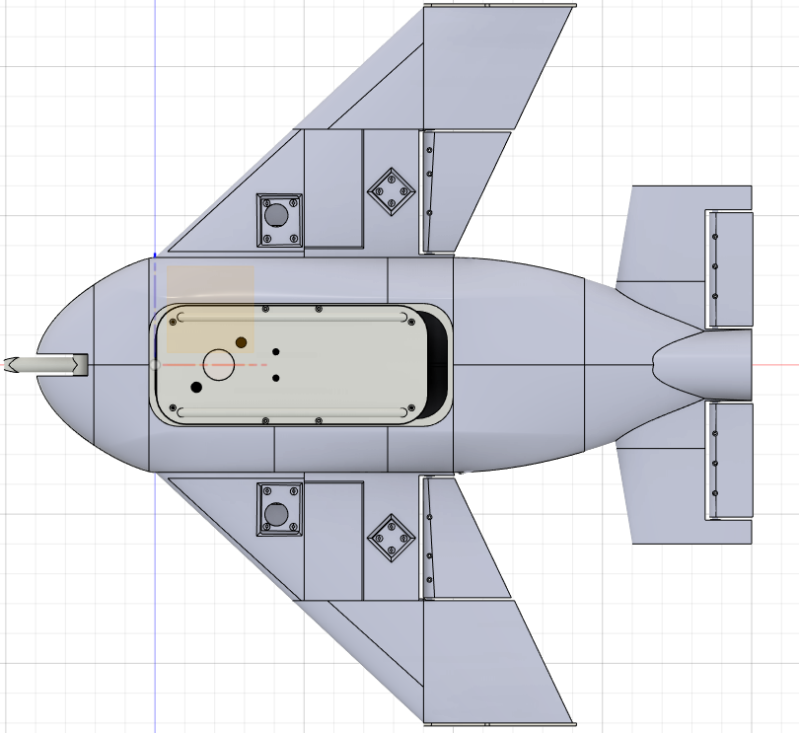
methodology
Newtonian approach to develop state space model(3 input 3 output)
Left flap, right flap, tail flap
Height, roll, pitch
Tuned and simulated different control methods
PID
LQR
Real life testing (saturday)

Slide 4
Improvements since last meeting
Finalized state space model
Implemented LQR and PID for various velocities
Implemented motor model and cascade control
Hardware communication and testing rig

Slide 5
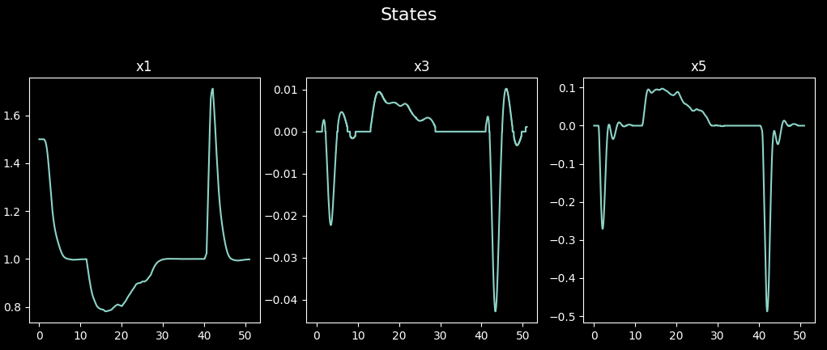
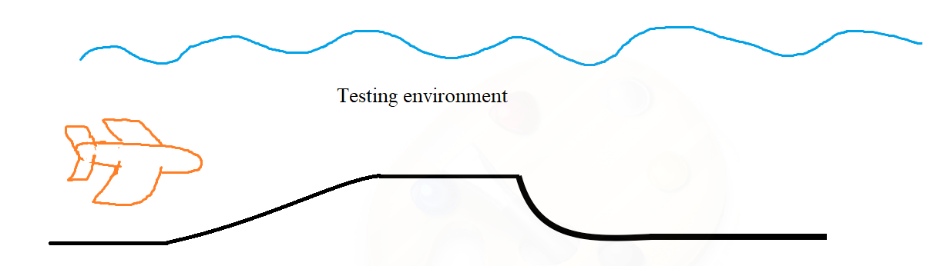
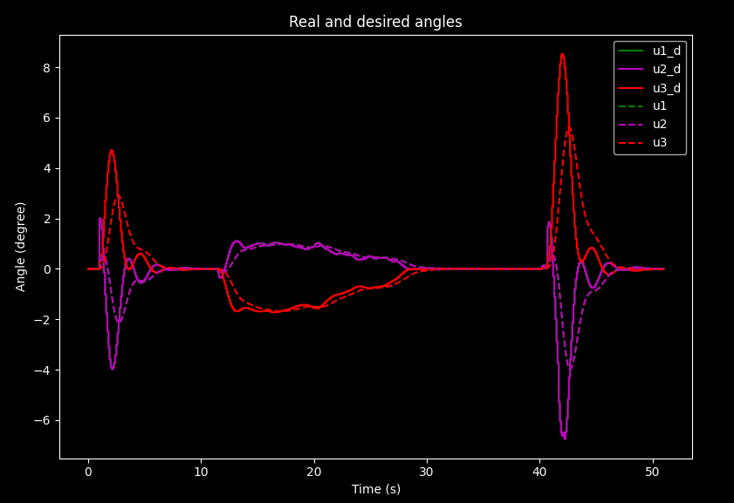
Simulation results
200 Hz -> 10 Hz due to hardware limitations
Motor model and cascade control

Slide 6
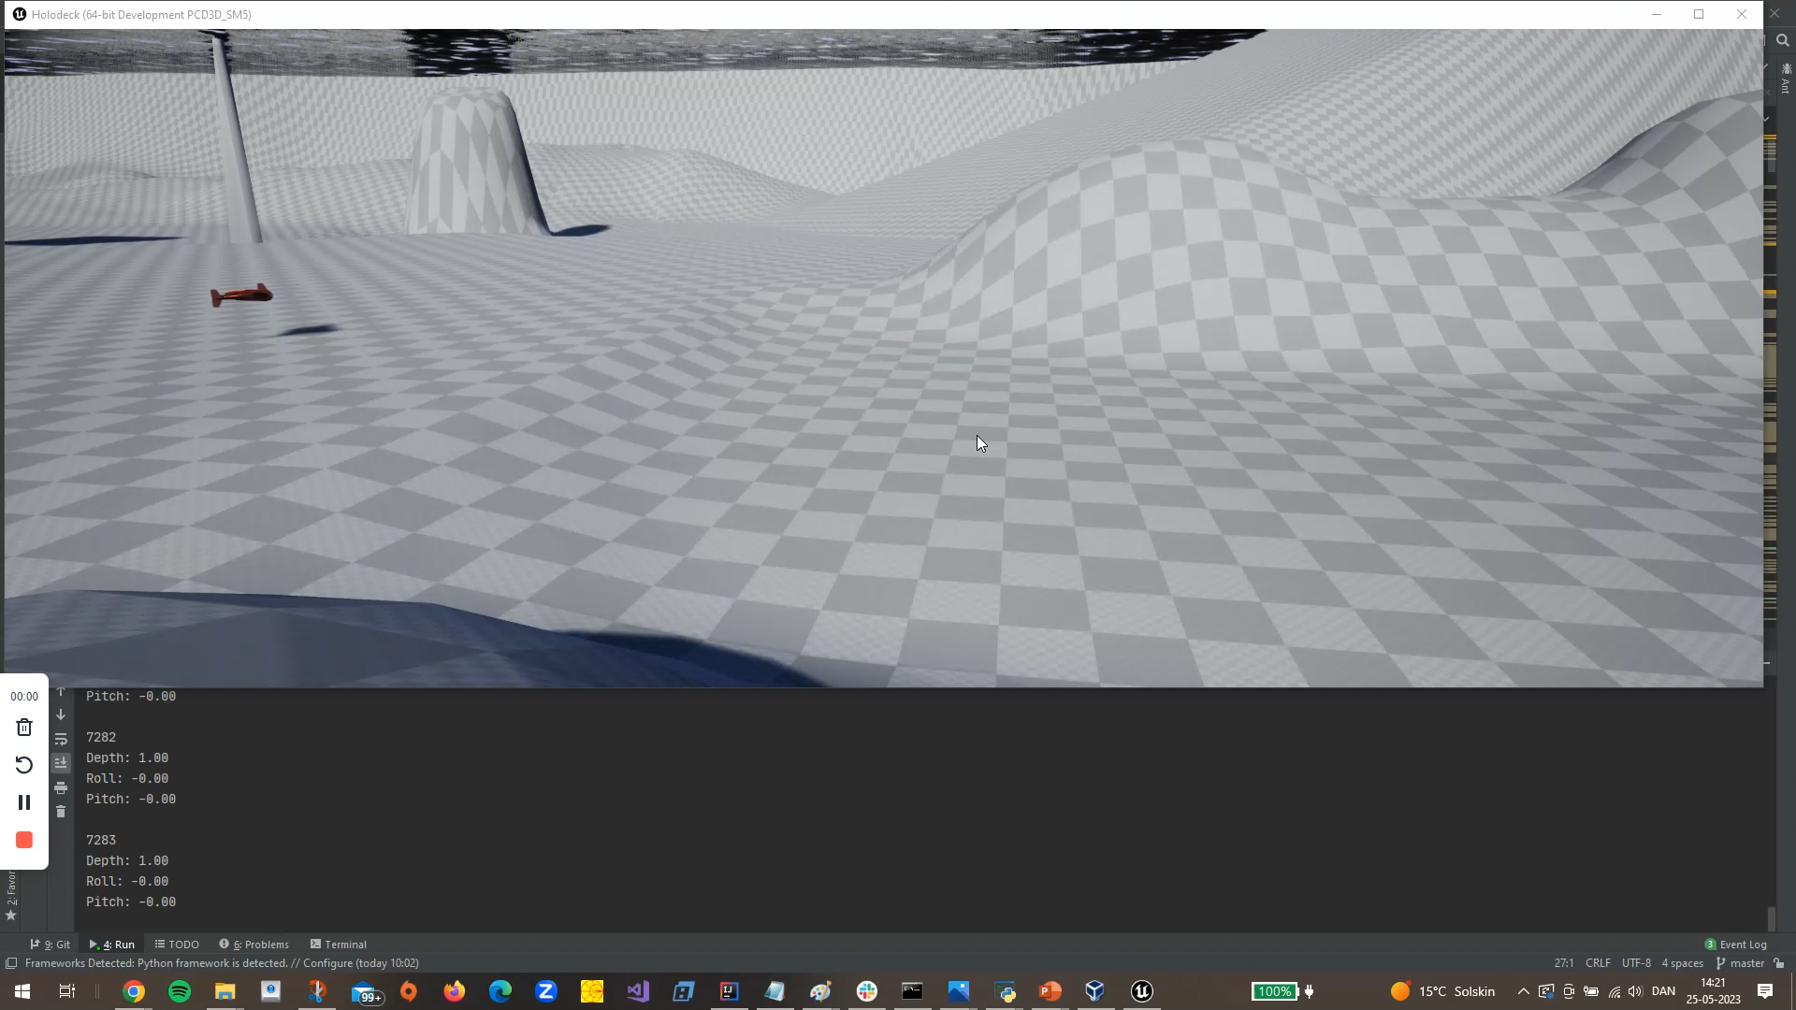

Slide 7
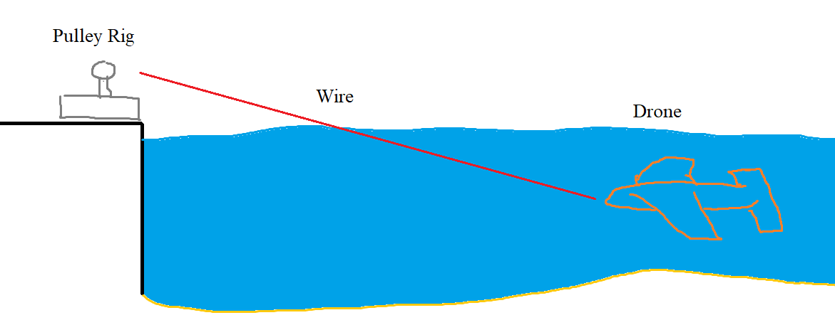
Real life testing
Setup
Test our developed control systems

Slide 8
Concerns
Non-linear system modeled as linear (linearization)
Low frequency system (10 Hz)
No encoder for actuators (hall sensors)

Slide 9
Q&A

